Slide 1
WELCOME
Impact of Your Health on Your Wealth
Peggy L. Farnworth, CPA, CFP
Securities offered through Securities America, Inc. Member FINRA/SIPC.
Advisory Services offered through Securities America Advisors, Inc.
Boise Retirement Coach and Securities America are separate entities.

Slide 2
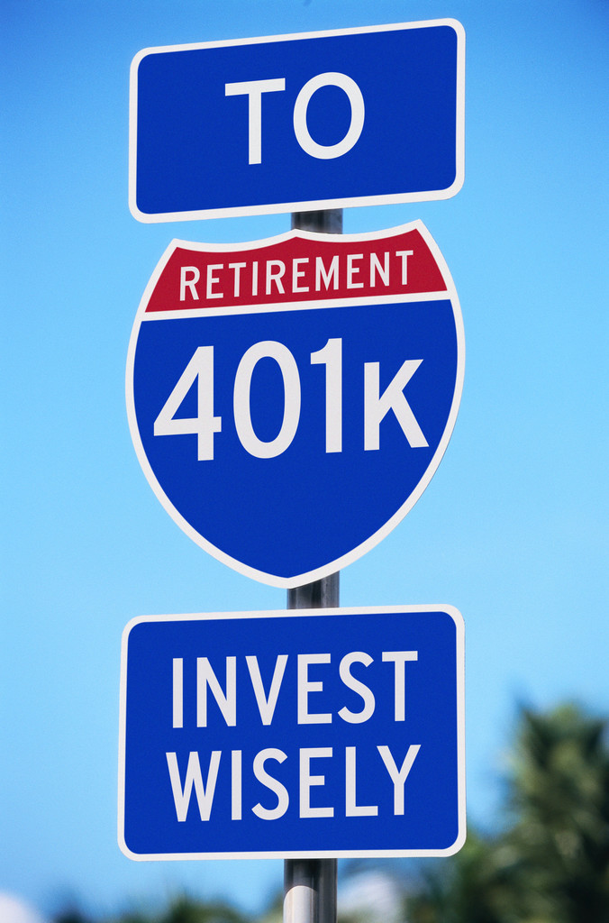
Fidelity® Retirement Savings Assessment Study
84% respondents concerned about covering health care costs
71% believe they are better than average health

Slide 3
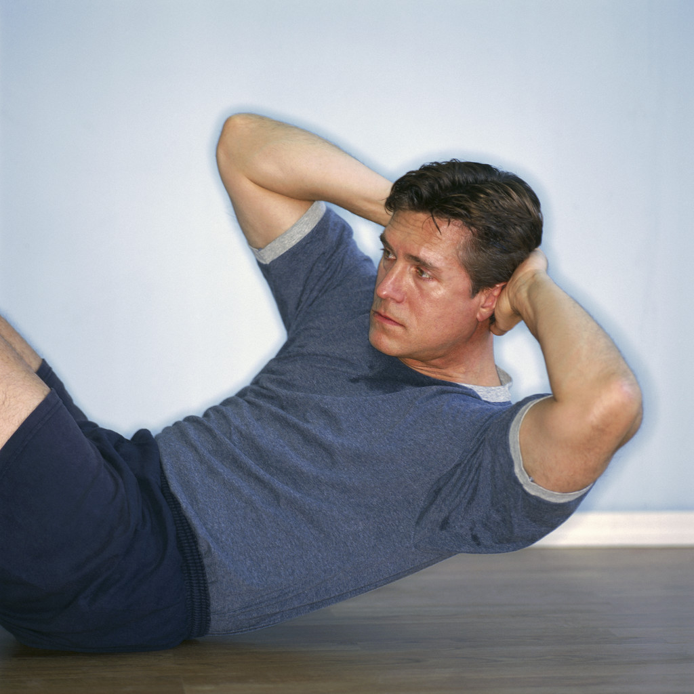
Centers for Disease Control and Prevention
35% of U.S. adults are obese
20% meet the Centers over all physical activity recommendations

Slide 4

AARP Public Policy Institute & Urban Institute
Current retirees
spend 8% of income
on health care
Future retirees will spend 18%

Slide 5

AARP Public Policy Institute & Urban Institute
Current retirees are experiencing lifestyle at 80% of average career earnings
Future retirees savings reflect 73% of average career earnings
Factor in health care costs and it is 55%

Slide 6

Fidelity® Retirement Savings Assessment Study
Pre-retirees (Age 55-64) 48% believe $50,000 to cover individual health care costs through retirement
Estimate $220,000 for average 65 year old couple - assume average life expectancy

Slide 7

United Health Care Company
Estimates $270,000 through retirement for healthy couple
As much as $150,000 more for those who smoke, obese and
high cholesteral

Slide 8
AARP Public Policy & Georgetown University
$2,854
1990
$4,878
2000
$8,402
2010
National Health Care
costs per person

Slide 9

Health Care Costs Challenges
Longer life spans
Rising Medical costs – higher than general inflation
Fewer employers offer retirees medical coverage insurance
Critical challenge of managing healthcare costs by Medicare & Medicaid

Slide 10
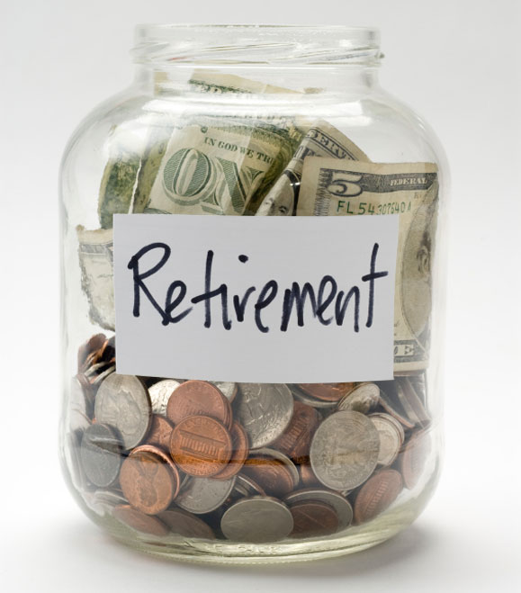
What do you do?
Savings levels of
10- 15% of income –
Starting earlier
is better
2. Savings as a regular part of your financial world – Includes bonuses and raises
Automatic savings
options 401(k),
payroll deductions,
bank transfers

Slide 11

What do you do?
Plan for health care costs
In retirement, Medicare covers 51% of
what employer
provided coverage
*Employee Benefit Research Center

Slide 12
Expect to Live Longer
 | 65-year-old man | 65-year-old woman | 65-year-old couple
50% chance of living to age: | 85 years | 88 years | 92 years
25% chance of living to age: | 92 years | 94 years | 97 years
* At least one surviving individual. Source: Annuity 2000 Mortality Table, Society of Actuaries. Figures assume that you are in good health. For illustrative purposes only.

Slide 13

Get Serious About Your Health
“Making smarter decisions about your health means you’re making smarter financial decisions, particularly when it comes to retirement. Being in good health will probably mean you’ll be more active in retirement – and you’ll likely be able to spend more on discretionary expenses such as travel. It’s also clear that doing all you can to stay healthy can make a big difference on essential costs as well, because you won’t have to spend that money on medical expenses. Simply put, not only can an apple a day keep the doctor away, it can very well help protect your retirement nest egg, too.”
John Sweeney, Executive Vice President of Retirement and Investing Strategies at Fidelity

